Slide 1
Welcome to the Flexible Fundamentals Workshop!
We have automatic captions! Turn them on to follow along if you’d like.
Keep your mic muted when you come in. We’ll get to talking as a group shortly!
Camera “off” or “on” is up to you! We understand you may need to go “off camera” at some moments and not others. This is your choice.
Say “hi” in the chat! Please introduce yourself. ☺

Slide 2
Today’s Plan
Welcome! Introductions to the Team and Some Zoom Logistics (5 minutes)
Breakout Room Time with Your Groups (15 minutes)
Quick Overview of Instructional Modes (5 minutes)
Workshop Norms and Outcomes (15 minutes)
Orientation to Canvas Course and Expectations/Opportunities for Future Sessions (10 minutes)

Slide 3
Flexible Fundamentals Workshop Team!
Faculty facilitation team:
Jean-Pierre Bayard: bayardj@csus.edu
Deanna Daly: deanna.daly@csus.edu
Clark Fitzgerald: fitzgerald@csus.edu
John Goldberg j.goldberg@csus.edu
Kevin Lovelace: lovelace@csus.edu
Kelly Jacobsen: kelly.jacobsen@csus.edu
Genevieve (Gen) Sparks: g.sparks@csus.edu
Academic Technology Center Facilitation Team:
Corrin Mattos: mattosc@csus.edu
Shawn Sumner: shawn.sumner@csus.edu
Cryssel Vera: cvera@csus.edu

Slide 4
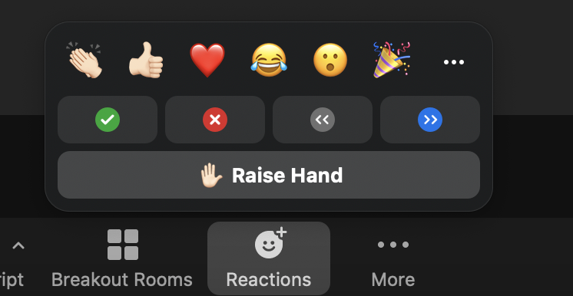
Ways We’ll Engage on Zoom as a Large Group
We’ll encourage use of Chat as a channel to connect with each other and share resources during the Zoom sessions. If you find the chat distracting, you’re not obligated to use it.
Use the Zoom “Reactions” panel to raise your hand if and when you’d like to speak. That way, everyone can see your interest!

Slide 5
We’re Here to Support Each Other & Explore
Photo by Daria Shevtsova (via Pexels)
Notes:
Brand new ways of thinking about academic technology at Sac State. Our purpose here is to work together and support each other through exploring these options, using our Canvas course as a place to start conversations and generate new ideas. Farmers’ market metaphor – check out some stands, see what you want to keep and don’t need to get what doesn’t interest you.

Slide 6
Schedule Overview
Mondays | Tuesdays | Wednesdays | Thursdays | Fridays
10:00 A.M.-10:50 A.M.
10:00 A.M.-10:50 A.M.
10:00 A.M.-10:50 A.M.

Slide 7
Schedule Overview
WEEK 1 (7/26-7/30): Conceptualizing Your Class Activities
Module 0 and Module 1 in Canvas
WEEK 2 (8/2-8/6): Trying Out Your Class Activities
Module 2 and Module 3 in Canvas
WEEK 3 (8/9-8/13): Revising Your Class Activities
Module 4 in Canvas

Slide 8
Meet Your Group Members! (15 minutes)
In breakout rooms, you will…
Share a little about you:
Name
Pronouns
Department
A course you’re planning to teach in a hybrid/flexible modality in the fall
Your favorite way to “unwind” (beyond what you do at Sac State ☺)
Come up with a team name!

Slide 9
Sac State Instructional Modes Overview
Hybridity refers to a blending and bridging of in-person and online experience.
The different instructional modes offer options for:
How often students meet in a particular space
How many students meet in a particular space
When students meet in a particular space
+

Slide 10
Sac State Instructional Modes Overview
Hybrid | Blended | HyFlex | HerkyFlex
 |  | Each student decides week-by-week how they will engage with their class. They can: Attend in-person at a designated time. Attend via Zoom at a designated time. Participate entirely asynchronously. | Each student decides, upon enrollment, if they will take the class in-person or online. The expectation is that the online and in-person class experiences will be happening at the same time, but can be joined by going to a brick-and-mortar classroom or via Zoom.
All students online at the same time and all students in-person at the same time.
Students rotate in cohorts for in-person attendance.
On some days, some students attend in-person; on other days they join via Zoom.

Slide 11
Sac State Instructional Modes Overview
Student Choice Models
Hybrid | Blended | HyFlex | HerkyFlex
 |  | Each student decides week-by-week how they will engage with their class. They can: Attend in-person at a designated time. Attend via Zoom at a designated time. Participate entirely asynchronously. | Each student decides, upon enrollment, if they will take the class in-person or online. The expectation is that the online and in-person class experiences will be happening at the same time, but can be joined by going to a brick-and-mortar classroom or via Zoom.
All students online at the same time and all students in-person at the same time.
Students rotate in cohorts for in-person attendance.
On some days, some students attend in-person; on other days they join via Zoom.

Slide 12
Workshop Norms Activity: Reflect
Individually, take a moment to write down your responses to the following questions:
What are some things that we can do to ensure that everyone feels that they have a voice and can equally participate in the conversations?
How would you like to see us show respect, care, and community for each other online?

Slide 13
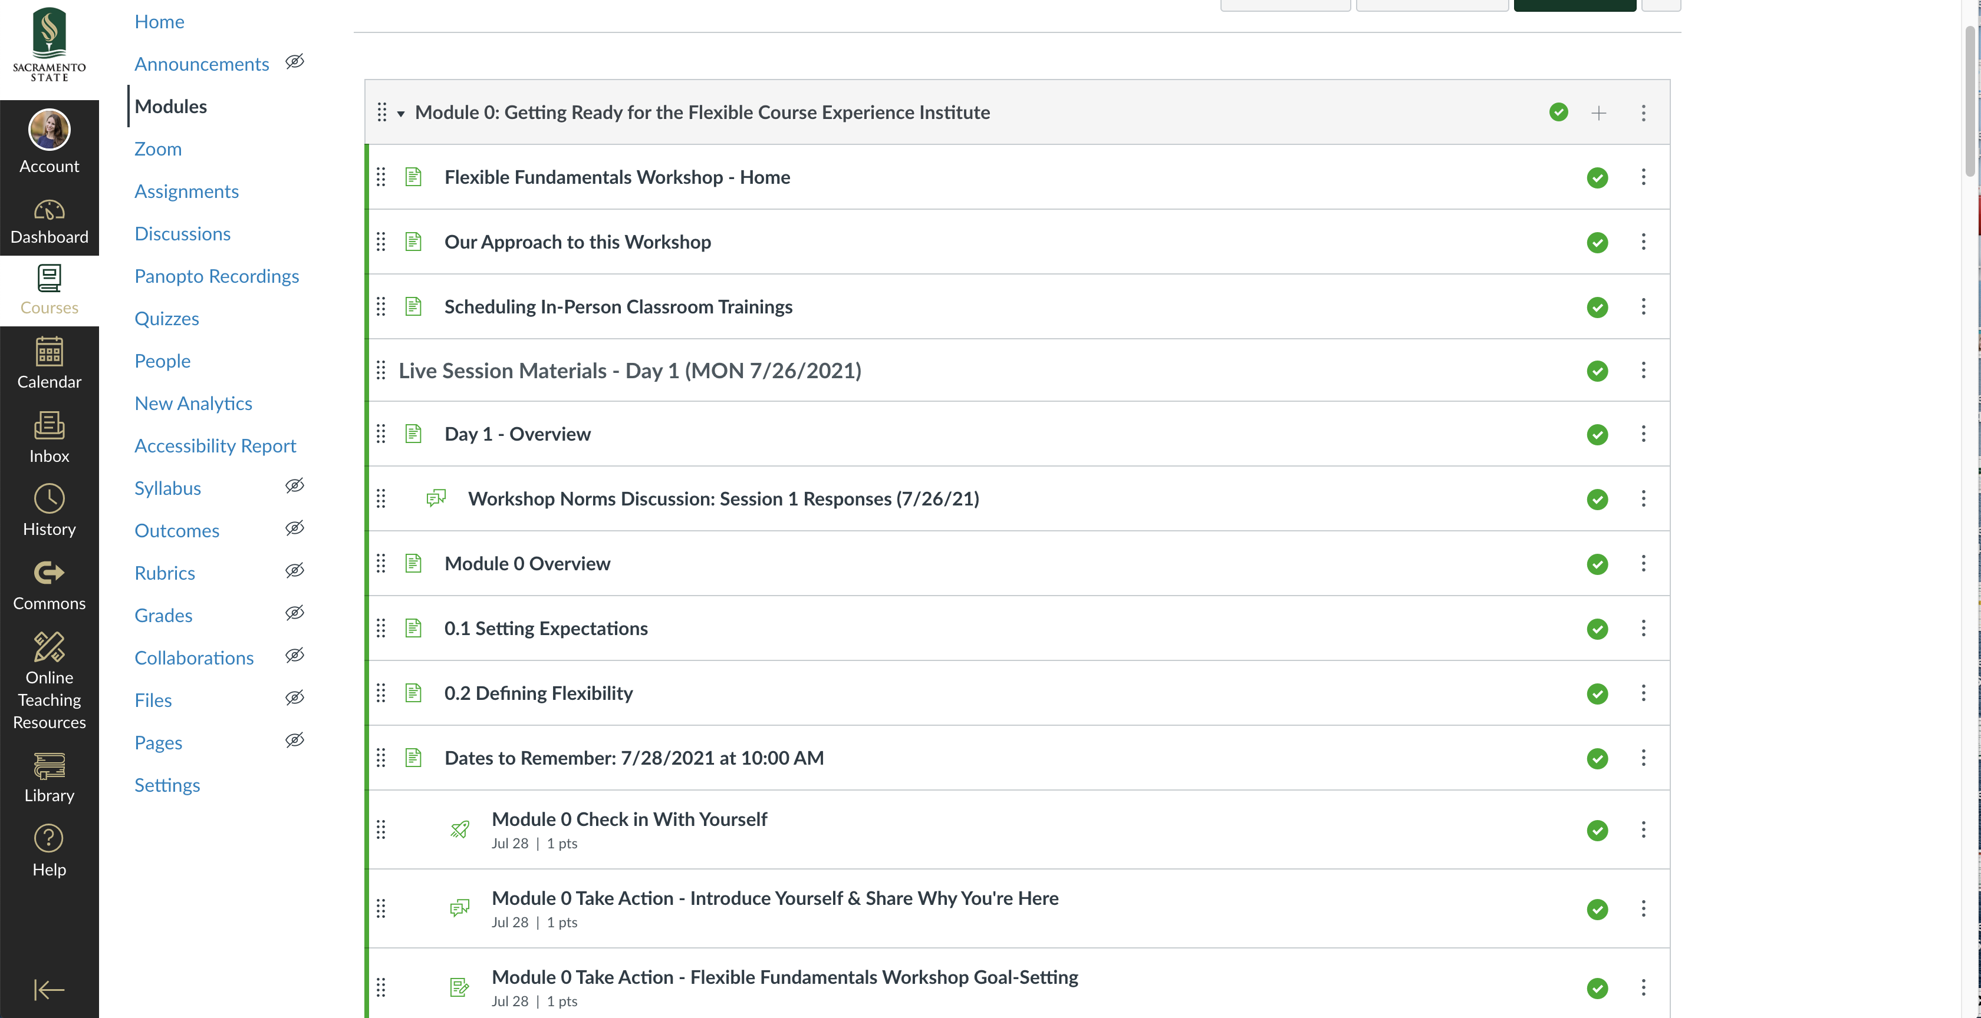
Workshop Norms Activity: Share

Slide 14
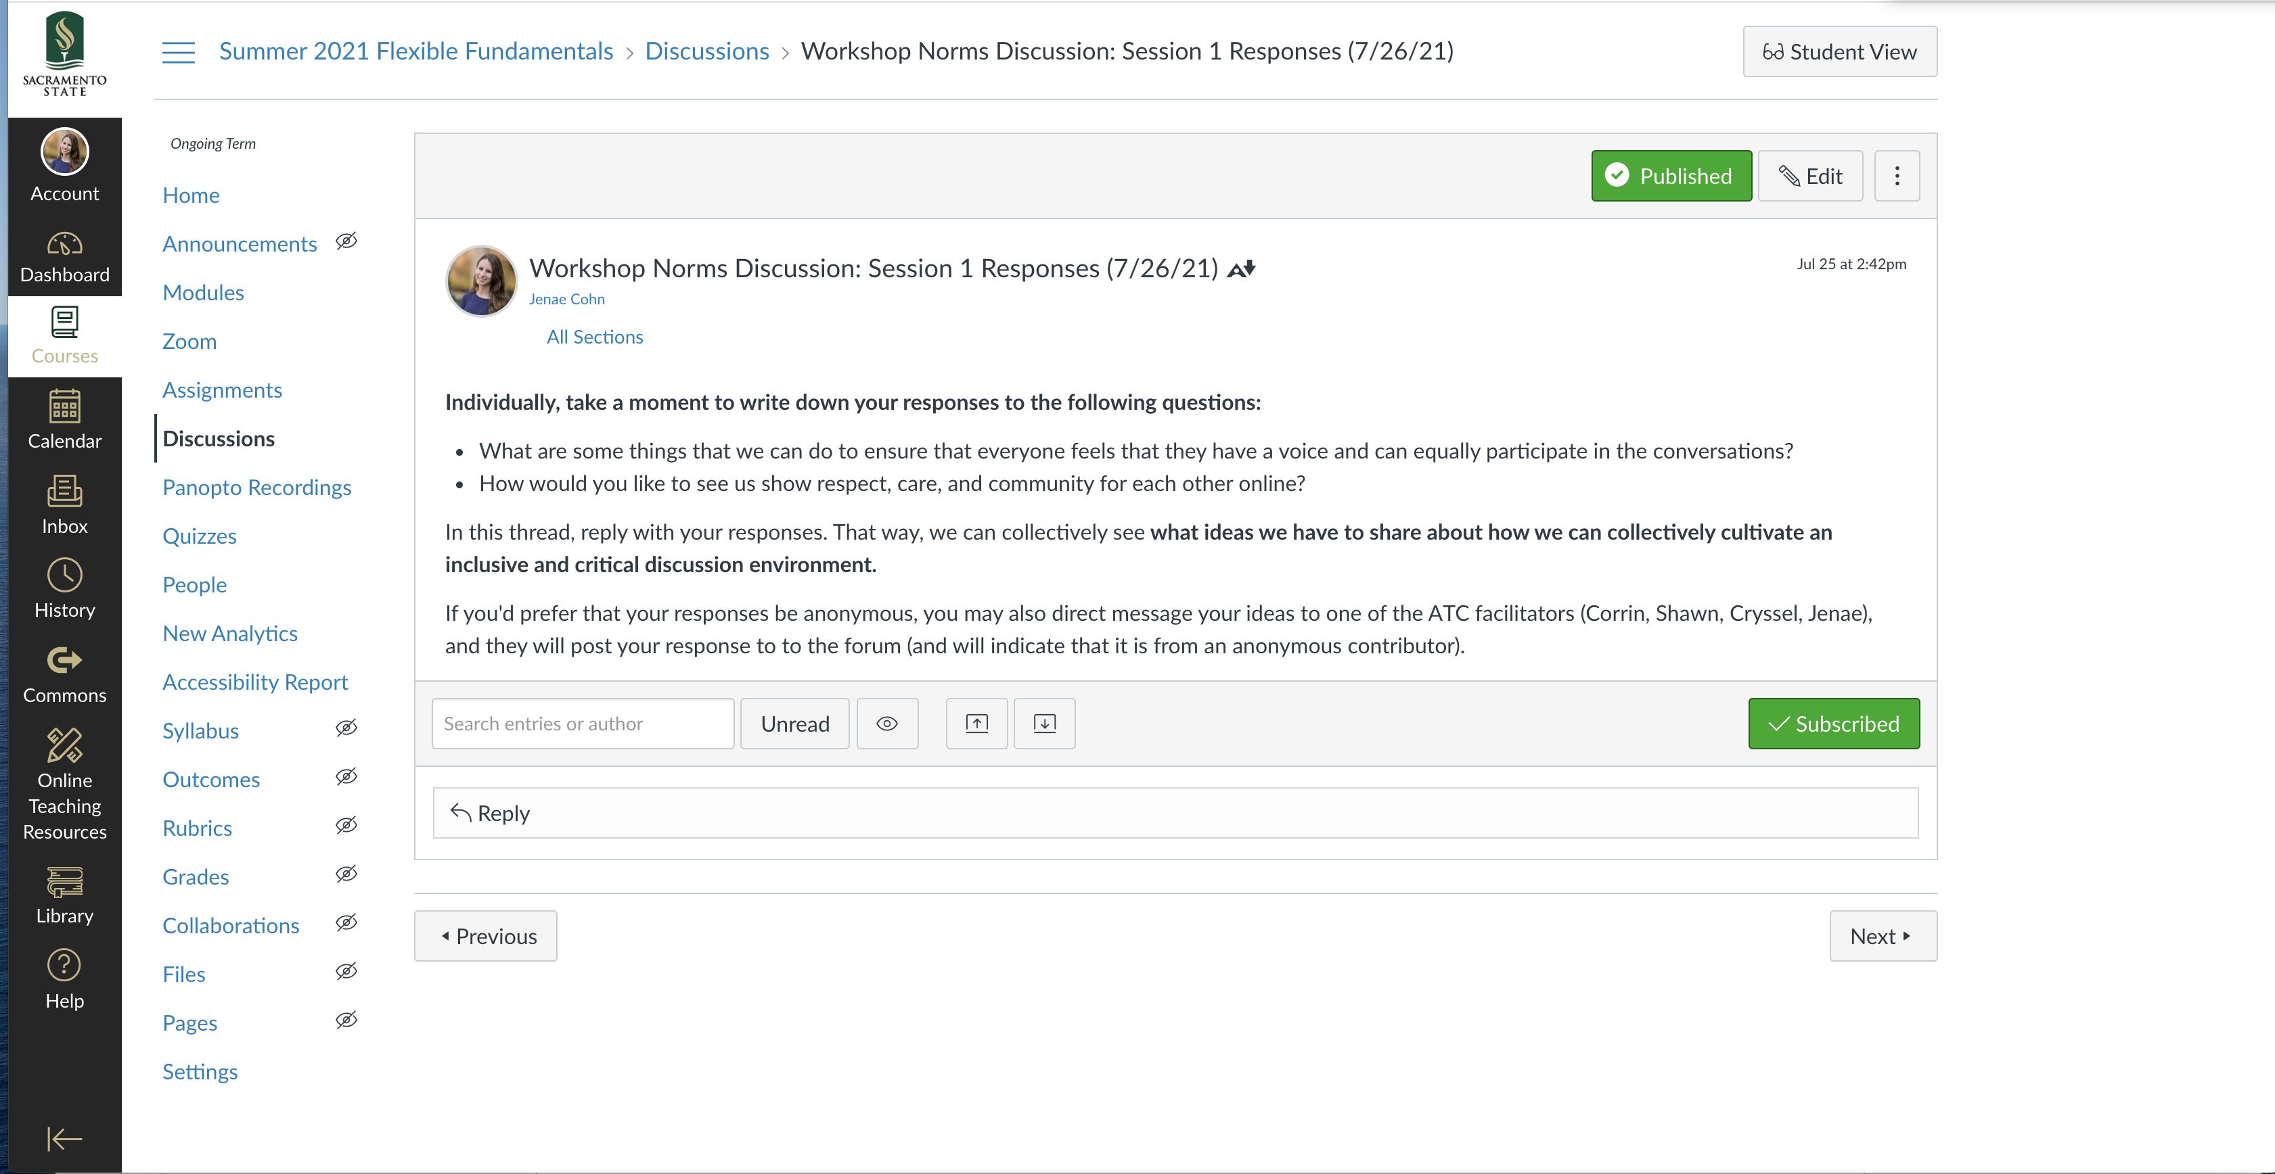
Workshop Norms Activity: Share

Slide 15
Collaborative Workshop Outcomes Activity
Individually, take a moment to write down your response to the following questions:
What is ONE THING that you want to be able to DO by the time that you finish this workshop?
Add your one thing that you’d like to do to our shared Outcomes Document.

Slide 16
Orientation to our Canvas Course

