Slide 1
Accessible Video for All: Closed Captioning Resources at Sac State
Presented by:
Cryssel Vera
Accessible Technology Center and UDL Program

Slide 2
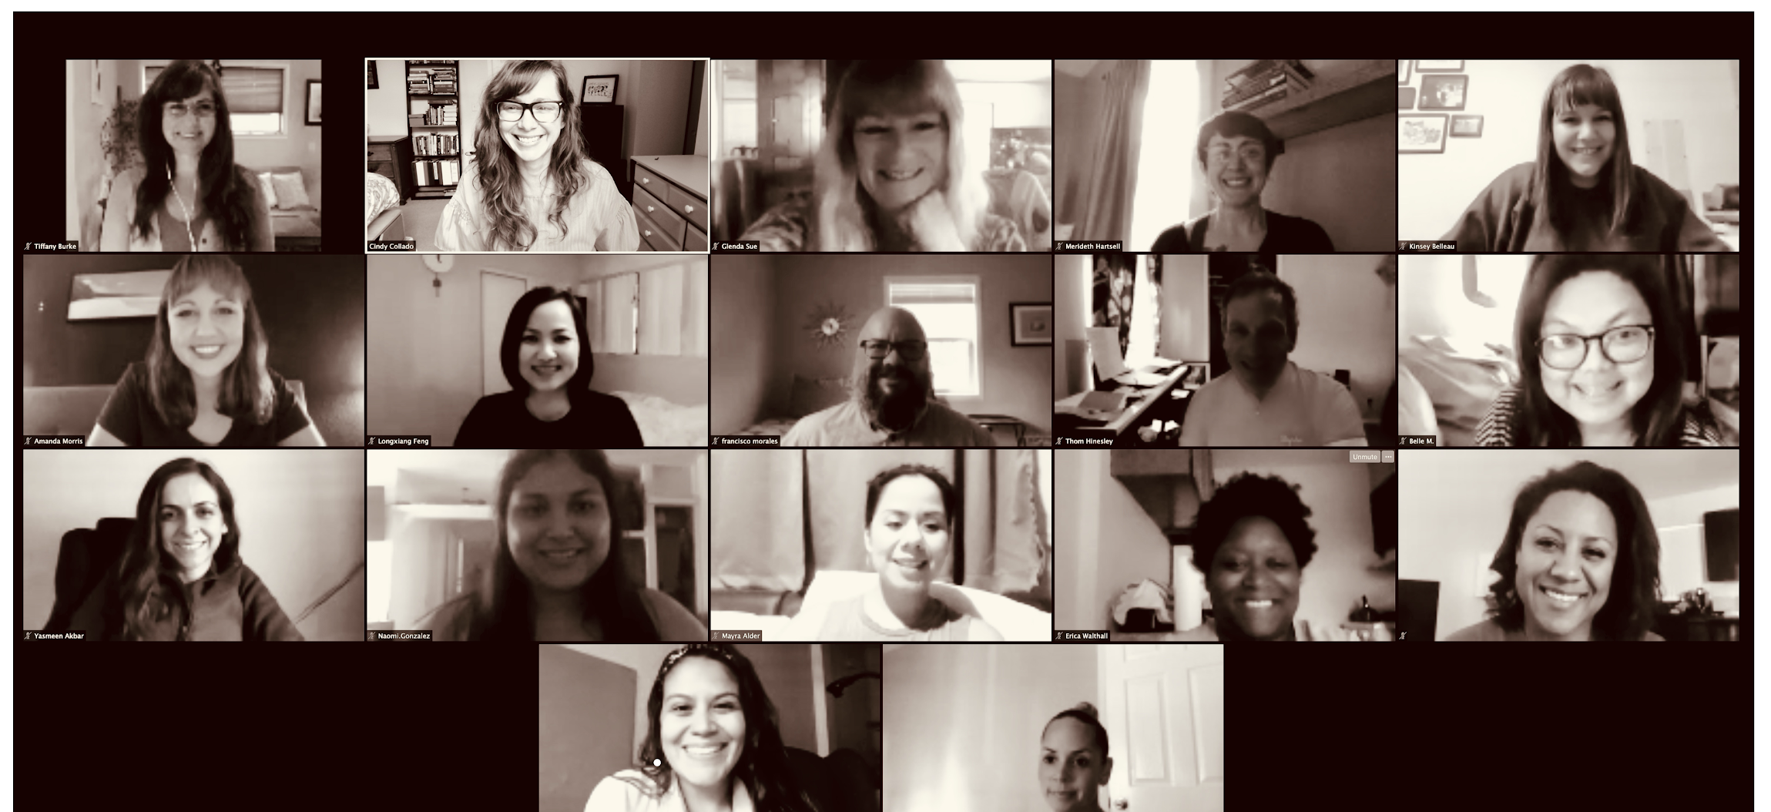
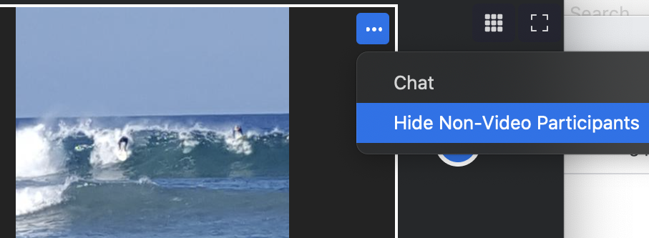
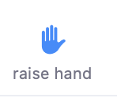
Inclusive Meeting Practices
Keep your video off when you are not asking a question/Commenting
Mute your audio when you are not asking a question/commenting
Type in chat. Use your full first & last name/pronouns
Best viewed in Gallery View. Enable Side by Side view for a single screen view
Click on 3 dots next to someone’s video and click: “Hide non-video participants”
If you need help or are experiencing challenges, click on “Participants” then click the blue “raise hand”

Slide 3
Enabling Auto-Transcript During Zoom Session

Slide 4
Session Objectives
Define “Closed Captions”
Explain when closed captions should be used
Explain the difference between caption types
Identify video tools available at Sac State to record and/or host video for courses
Describe how to request closed captions for videos you create/host on Sac State supported video tools
Review how to post closed-captioned videos in a Canvas Course

Slide 5
What are Closed Captions?
Captions are the textual representation of a video's soundtrack.
Critical to users who are Deaf or Hard of Hearing
Provide information for sound effects, speaker identification and non-speech elements
Quality is Critical to be considered accessible
Proper grammar, punctuation, syncing to audio
Written in the source language of video
DCMP Captioning Key Resource
Notes:
Benefits (discussed further in UDL portion)
Helpful for improving reading and listening skills of others
Captioning Key

Slide 6
When are Closed Captions Needed?
Course where DOHH Student Enrolled​
Event where DOHH Audience will be present​
If content will be made available to a large audience​
If content is public facing or will be used over a long span of time
Provide a captioned format anytime it is available!​

Slide 7
Other Caption Types:
Automatic Captions – As seen on YouTube
Subtitles – See Subtitle Example
Subtitles for Deaf or Hard of Hearing
Open Captions – See Open Captions Example
Live Captions
Audio Description – Sample Video with AD
Closed Captioned Video Example
Notes:
What are automatic captions?
Machine generate captions
Captioning is not 100% accurate. Some accurate captioning does not equal good captioning. “It is like listening to garbled audio”
Does not have the ability to follow quality guidelines for grammar and punctuation
What are subtitles?
Assume the viewer can hear the audio but doesn’t know the spoken language
Subtitles are intended for hearing viewers who do not understand the language. For this reason, subtitles only show the spoken content but not the sound effects or other audio elements.
Used to refer to translations of a foreign film for example
What are Subtitles for the Deaf or Hard of Hearing
Are subtitles that combine the information of both captions and subtitles
Assumes that the viewer cannot hear the audio (like with captions).
Intended to emulate closed captions on media that does not support closed captions, such as digital connections like HDMI
What are open captions?
Captions that are added to the video file or media player and cannot be turned off. (Are “burned in” hard coded into video file)
Audience cannot turn off captions off.
Makes videos accessible regardless of where they are viewing them (if a system does not support CC open captions are an option)
What is Audio Description
Audio description is an additional audio track that provides a description of the visual elements of a video, TV broadcast or performance. Unlike closed captions, which are becoming widespread across the web, audio described videos are rarely available online. Provides access to users who are blind or low vision.
Audio Description is available as a separate service via our third party Captioning Vendor Captionsync or you can add a separate audio track in Panopto under Audio Descriptions tab.

Slide 8
Bridging Universal Design for Learning and Captioning “Representation”

Slide 9
What is Universal Design for Learning?
Framework for curriculum development that is inclusive of all learners
Proactive design and delivery of instruction that addresses learners of all backgrounds and learning styles regardless of disability
Accessibility is ONE aspect of UDL
Notes:
Universal Design for Learning (UDL) is a set of principles for curriculum development that give all individuals equal opportunities to learn. UDL provides a blueprint for creating instructional goals, methods, materials, and assessments that work for everyone--not a single, one-size-fits-all solution but rather flexible approaches that can be customized and adjusted for individual needs

Slide 10
Representation
Representation is the “What” of learning and provides students with options for:
Perception
Language and Symbols
Comprehension
Let’s take a moment to discuss how closed captioned video touches each of these areas
Notes:
Perception: Interact with flexible content that doesn't depend on a single sense like sight, hearing, movement, or touch.
Checkpoints:
Offer ways of customizing the display of information
Offer alternatives for auditory information
Offer alternatives for visual information
Language and Symbols: Communicate through languages that create a shared understanding.
Checkpoints:
Clarify vocabulary and symbols
Clarify syntax and structure
Support Decoding of text, mathematical notation, and symbols
Promote understanding across languages
Illustrate through multiple media
Comprehension: Construct meaning and generate new understandings.
Checkpoints:
Activate or supply background knowledge
Highlight patterns, critical features, big ideas, and relationships
Guide information processing and visualization
Maximize transfer and generalization

Slide 11
Perception Opportunities
How many senses does someone use when watching a closed-captioned video?
How can students use the video player to customize their experience with captioned video?
How do closed captions offer alternatives for auditory information? For visual information?

Slide 12
Options for Language and Symbols
Can you think of any scenarios in your class where closed captions would clarify vocabulary used in your course?
How do/would closed captions help support understanding in your course?

Slide 13
Comprehension Opportunities
How could closed captions help to highlight patterns and or relationships in content?
How could closed captions help with information processing e.g. retention?

Slide 14
Captioning Options for Sac State Supported Video Tools

Slide 15
Captioning Options (1 of 2)
Zoom:
cloud-based audio/video web conferencing and recording application
Synchronous session: enable Live captions or have someone provide captions during session
Asynchronous session: auto transcription for cloud recordings
Panopto Video: For Asynchronous Video
Automatic Transcription/Captioning
Request Captions via 3rd Party Vendor “Automatic Sync Technologies”

Slide 16
Captioning Options (2 of 2)
Canvas Video (created with built-in Media Recorder)
Use Free Amara Subtitle Creation Tool to Create your own caption file and upload via CC option
Download Video and Submit Captioning Request to ATC for captioning via 3rd Party Vendor
Mediasite Video: (Going away May '22)
Captioning via 3rd Party Vendor “Automatic Sync Technologies”
YouTube/Vimeo Video: Submit Captioning Request to ATC for captioning via 3rd Party Vendor

Slide 17
Zoom Video How to Enable Closed Captioning

Slide 18
Zoom
Cloud-based audio/video web conferencing and recording application
Offers screenshare, live chat, polling, breakout rooms
Automatic Live transcription
Closed Captions for Cloud Recordings
Available to Faculty, Staff and Students
https://csus.zoom.us/

Slide 19
Enable Closed Captioning in Zoom
For Real Time/Live Captions
Login to your external Zoom Account
Settings > In Meeting Advanced > closed captioning

Slide 20
Enabling Auto-Transcript During Zoom Session

Slide 21
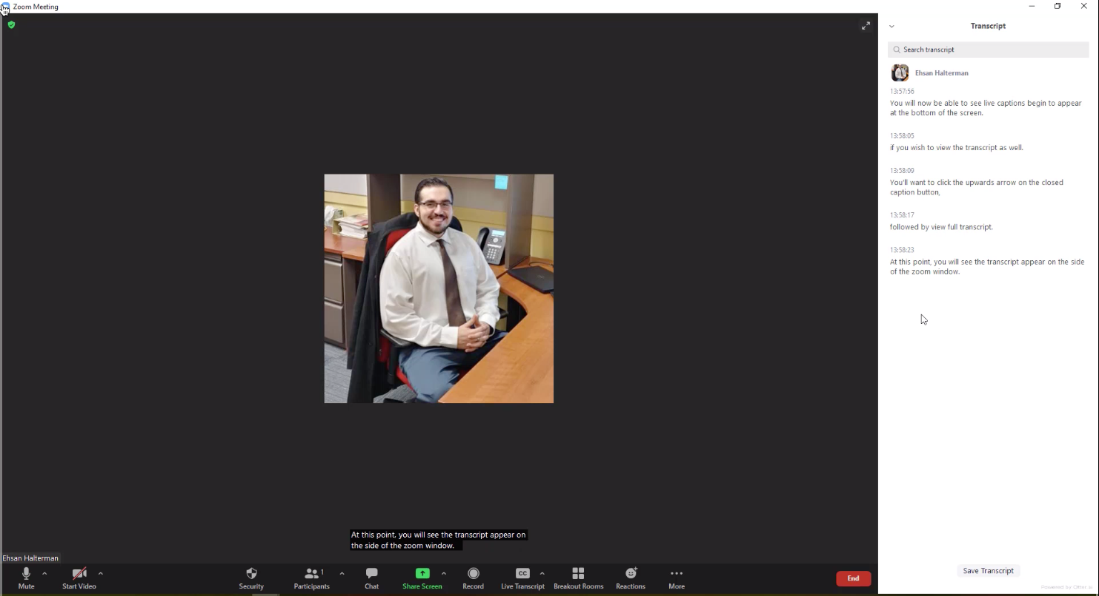
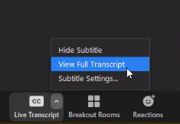
Viewing Full Transcript

Slide 22
Zoom Cloud Recordings – Transcription
Audio Transcription Automatically Generated (.vtt file)
Transcript displays to the Right of Video
Use CC button to Display Transcript Text on Video
Edit Transcripts as needed via external Zoom account: http://csus.zoom.us

Slide 23
How to Access Zoom Recordings
Canvas
From Zoom page in course, click Cloud Recordings Tab
Select Recording and playback file labeled “Recording-1”
External Zoom Account (csus.zoom.us)
Go to Recordings page and choose Cloud Recordings
Select Recording and playback file labeled “Recording-1”
Get “Copy Shareable Link” if needed for posting

Slide 24
Zoom Audio Transcript & Closed Captions

Slide 25
Panopto Video How to Request Closed Captioning

Slide 26
Panopto (1 of 2)
New Lecture/Capture system to replace Mediasite in Spring 2022
Use Panopto to record/upload class lectures, for video assignments
Automatic Closed Captioning is integrated into Panopto system
Not 100% accurate but you can edit captions as needed
Option to Request Closed Captioning from 3rd Party Vendor for accurate captioning!
Notes:
Panopto link external: https://csus.hosted.panopto.com/
Resource Link: https://www.csus.edu/information-resources-technology/panopto/
Official Panopto Launch 1/24/22, Mediasite Officially Retired5/1/22
Panopto Uses:
Faculty + Staff
Upload and edit existing videos from your computer, Camtasia, or Zoom
Create and edit new videos
Pre-record or capture live lecture capture
Organize course video libraries in Canvas, Zoom, or another portal
Embed quizzes + short assessments
Adds automatic screen-generated captions
Syncs with CaptionSync to provide 100% ADA-compliant captions
Automatically syncs recordings to the Canvas course library
Generates a search term/keyword library and time-stamped "table of contents" for quick content search
Students
Create their own videos
Find, sort, and view course videos with closed captions
Keyword searches within course videos
Take quizzes within course videos
Leave comments at time-stamped moments in a video’s timeline for class discussion.

Slide 27
Panopto (2 of 2)
Access Panopto directly from within Canvas
It is not necessary to upload Zoom recordings into Panopto
Display under My Folder > “Meeting Recordings” folder

Slide 28
How to Login to Panopto
External Site
Through Canvas
Go to: https://csus.hosted.panopto.com/
Choose “Canvas (CSUS SSO) and click “Sign in”
Login with Sac State Credentials
Go to a Canvas Course and click “Settings” from course menu
From “Navigation” Tab locate “Panopto Recordings” option and select “Enable”
Panopto link is now available on course menu

Slide 29
How to Request Captions in Panopto
Step 1: Delete Machine Generated Captions
Step 2: Request Vendor Captioning
Locate Video and Click “Settings”
Click the “Captions” menu option
Expand “Available Captions” area
Click Delete Captions (deleted machine generated captions)
Close settings window
Open “Settings” again,
Under “Request Captions” Select “AutomaticSync Captions (AST CaptionSync)” option for captions through vendor.
Click “Order” button to submit request
Captions take 3-5 business days to process

Slide 30
Panopto Demo
Process to Login and Request Captions Demonstration

Slide 31
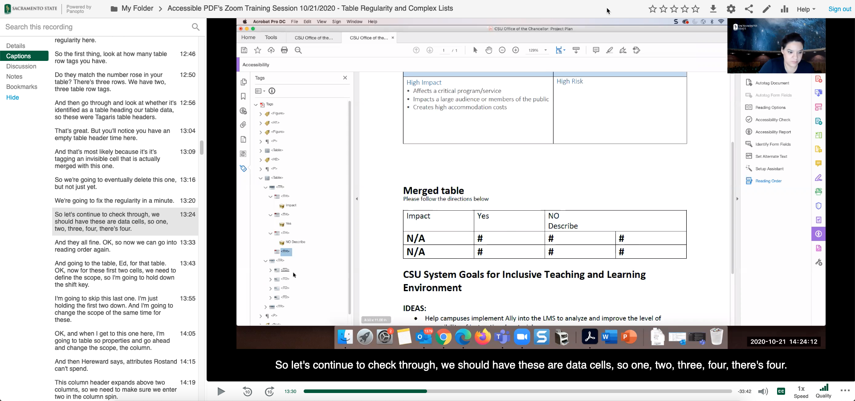
Panopto Video with Captions
Sample Panopto Recording with Captions
Notes:
https://csus.hosted.panopto.com/Panopto/Pages/Viewer.aspx?id=12cbd207-c0cd-4fe8-a57a-adb701829486
Login to Captioning accout

Slide 32
How to Request Closed Captioning Mediasite Video

Slide 33
Mediasite
Lecture Capture System & Media Server (to be replaced by Panopto Spring 2022)
Record or Upload Existing Videos
Edit Videos (Basic Cuts/Edits)
Request Free Closed Captions

Slide 34
Upload Video to Mediasite
Video should be in .mp4 format
Login to Mediasite or enable My Mediasite Link in Canvas
Add Media from computer
Wait for it to upload/process
Edit Visibility –Viewable
Request Closed Captions
Get Share Link/Embed Code or Use Canvas to Locate Video

Slide 35
Mediasite Interface

Slide 36
Mediasite - Request Closed Captions
Open Video
Edit Details Link
Delivery > Audio Transcription
Choose Provider for Captioning: Automatic Sync Technologies
Save
Captions process 3-5 days
CC button becomes available on Video

Slide 37
Request Captions in Mediasite

Slide 38
Canvas Video How to add/request Closed Captions

Slide 39
Canvas Video
Video Created or uploaded with built-in “Upload/Record Media” option in Rich Content Editor Areas
Upload caption file directly through RCE – video options
Use Free Amara Subtitle Creation Tool to Create your own caption file and upload via CC option
Download Video and Submit Captioning Request to ATC
Notes:
Webvtt format is visible on mobile ios regular srt does not load on ios

Slide 40
Demo Canvas Video

Slide 41
How to Request Closed Captioning Other Video Tools

Slide 42
Other Video
Video not hosted on Zoom, Panopto or Mediasite?
E.g. YouTube, Vimeo, exported from Camtasia.
Submit Request Form on IRT site
Provide URL’s to videos or Video .mp4 File
Captioning Takes 3-5 Business Days
Notes:
If your video is not stored/hosted on Panopto or Mediasite, then you can request closed captioning via an online form where you provide the details for your request including the video/audio files or links to YouTube videos. The turnaround time for closed captions is typically 3 business days but can be up to a week.

Slide 43
How to Post Captioned Video

Slide 44
How to Post Captioned Video to Canvas
Enable Course Menu Links: Enable “Zoom” and “Panopto Recordings” links in course menu
Embed Video in Rich Content Editor Area(s): Use Apps or Panopto Recording buttons on toolbar to embed video
Post to Modules: Add video share link as External URL

Slide 45
App and Panopto Recording Buttons on RCE

Slide 46
Embed Mediasite Video in Canvas Course

Slide 47
Embedded Panopto Lecture

Slide 48
Captioning Resources at Sac State
Panopto Captioning
Zoom Captioning
Using Live Captioning in Teams Meetings
Mediasite Captioning

Slide 49
Captioning and Universal Design Resources
CAST – The UDL Guidelines
Closed Captioning as Universal Design
How captions increase ROI and audience for media creators
Sound is Not Enough – Captioning as Universal Design
Caption It Yourself Basic Guidelines DCMP
SDH Subtitles vs. Closed Captions

Slide 50
YouTube Resources
3 Ways to Caption Your YouTube Videos
How to Search for CC Videos on YouTube
Audio Descriptions on YouTube
How to Add Subtitles to YouTube Video

Slide 51
Need Assistance?
Contact the Academic Technology Center
Send us an email: atc@csus.edu
Schedule a consultation
Get Drop-in Virtual Support
Check out our Captioning Resources on the Online Teaching Resources course

Slide 52
Academic Technology Center
We support your course accessibility design
Trainings and workshops on accessible course materials
One-on-One consultations on formatting and tool functionality
Run comprehensive accessibility checks on your instructional materials
Notes:
Technology Supports
Trainings and workshops on accessible course materials
Canvas support including apps and tools
Instructional technology tools
MediaSite and Zoom
One-on-One consultations
Run comprehensive checks on your instructional materials

Slide 53
Thank you!

