Slide 1
Accessible Word Documents Document Formatting Basics
Presented by: Cryssel Vera

Slide 2
Objectives
Learn accessibility elements needed to design an accessible document
Identify tools/options in MS Word that address accessibility in documents​
Assess document accessibility and fix issues​
Create an accessible document

Slide 3
Elements for an Accessible Document (1 of 2)
Styles and Formatting for document structure,
Alternative Text for Images,
Descriptive Labels for Links,
Simple Tables with Table Headers that are identified,

Slide 4
Elements for an Accessible Document (2 of 2)
No unnecessary white space/blanks – control with styles/tab stops
Sufficient Color Contrast
Review documents with built in Accessibility Checkers
Make alternative formats available if needed

Slide 5
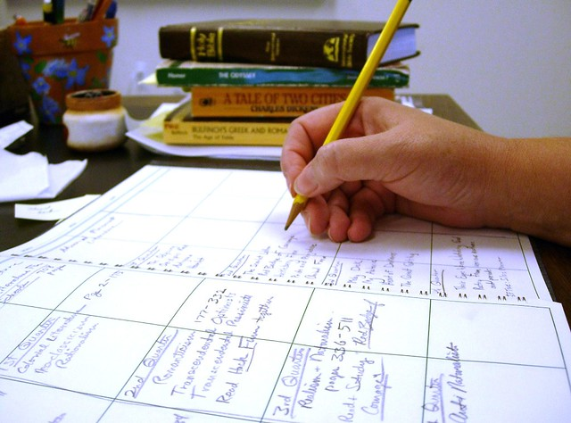
What are Instructional Materials?
Electronic Distributed Materials
Syllabus
Word Docs, PPT, PDF, WebPages
Textbooks
Canvas Course Content
Faculty Website Content
Videos and Audio…

Slide 6
What makes a document Accessible?
Is designed and structured to be used effectively by people with disabilities.
Assistive technology devices and software should be able to interact/access content effectively

Slide 7
What is Assistive Technology?
“Products, equipment, and systems that enhance learning, working, and daily living for persons with disabilities”
Screen Readers – JAWS Job Access With Speech : Used by low vision or blind users.
Magnification Software – ZoomText, MAGic: Used by low vision users.
Scan/Read – Kurzweil : Used by users with learning disabilities.
Captions/Subtitles
Speech Recognition
Trackball Mouse
Braille Keyboard
Watch a demo about Assistive Software
Notes:
Screen Readers: https://webaim.org/articles/visual/blind#screenreaders
Magnification Software: https://www.zoomtext.com/products/zoomtext-magnifierreader/
Scan/Read Software: http://www.kurzweiledu.com/default.html

Slide 8
How do Screen Readers Work?
Read computer/mobile screen text-to-speech output or by a refreshable Braille display.
Screen readers read from Left to Right/ Top to Bottom
Keyboard hotkeys are used by screen reader users to browse content, skip to areas (mouse is not used)
Reading Order/Proper Structure are key!

Slide 9
Job Access With Speech JAWS Keystrokes
JAWS Hotkeys – Browsing Keystrokes
Insert + down arrow = Say All,
CTRL = Interrupt Speech
Insert + Up Arrow = Say Line,
Insert + Left Arrow = Say prior word
Insert + Right Arrow = Say next word
Insert + F6 = List of Headings
Insert + F7 = List of Links
Insert + F9 = List of Frames
Insert + F5 = List of Form fields
Notes:
Other Screenreaders Include:
NVDA Screenreader (free for everyone): https://www.nvaccess.org/
VoiceOver Available on all Mac OS or iOS: https://www.apple.com/accessibility/vision/

Slide 10
Demonstration
Accessible Document Demo
What does a blind user hear?
Accessible Syllabus Navigation with JAWS
Inaccessible Syllabus Navigation with JAWS

Slide 11
Document Structure

Slide 12
Planning Document Structure
How is your document organized?
Contains a title?
Contains different sections?
Lists?
Layout?
Combination of text and graphics?
Use of links?
How should my document be read so that it is coherent?

Slide 13
Formatting and Meaning example 1
California
Sacramento
San Francisco
Texas
Austin
Dallas

Slide 14
Formatting and Meaning Example 2
California
Sacramento
San Francisco
Texas
Austin
Dallas

Slide 15
Formatting and Meaning Example 3
California
Sacramento
San Francisco
Texas
Austin
Dallas

Slide 16
Document Structure Example
Example 1: Documents with no styles/formatting are difficult to read
Example 2: Document that is structured via styles and formatting are organized and can be processed by students more easily

Slide 17
Heading Structure Example
Before: No Headings or Formatting
After: Headings Added to Main and Section Titles

Slide 18
Document Readability

Slide 19
Recommendation for Fonts
Use the most readable fonts: (size, family, color, style)
Sans Serif Fonts: Verdana, Arial, Tahoma
Plain endings, no flared extensions, no extra ornamentation, easier to read
Serif, Cursive, Fantasy fonts
Difficult to read, extra ornamentation, strokes at tips
Limit the number of fonts used
Avoid small font sizes, use 12-18 point
Notes:
A font family (Serif, Sans Serif, Cursive, Monotype, Fantasy fonts) is a set of fonts all with the same typeface, but with different sizes, weights and slants. Font families and size have been constructively applied to the presentations. The presentations only have two font families consisting of Sans Serif fonts in the text boxes. Moreover, the font size is not smaller than 24 points. Font families such as Arial, Verdana and Tahoma, rather than Times New Roman, are planned for the text-based content.
Verdana, Tahoma, Trebuchet MS, and Georgia, were developed specifically for use in electronic media, and are now quite common on both Windows and Mac platforms, especially if Microsoft Word is installed on the computer.

Slide 20
More Font Recommendations
Availability of fonts across computer operating systems?
Use Real text vs. text within graphics
Limit font variations such as bold, italics, underline, all caps
Reserve Underline Text for Links
Italics are difficult to read on screen
Avoid using all UPPERCASE LETTERS (are you yelling?)
Don’t rely on font color, size, and overall font look to convey meaning

Slide 21
Font Family
Sans Serif
Serif
Arial
Tahoma
Verdana
Times New Roman
Georgia
Book Antiqua
Notes:
WebAIM: http://www.webaim.org/techniques/fonts/
Serif, Cursive, Fantasy, Monospace

Slide 22
Color Contrast

Slide 23
Use Effective Color Contrast
Use Colors that contrast
Light on dark , dark on light
These colors don’t contrast
Don’t rely on color to convey meaning
Avoid using combination of many colors
Download Colour Contrast Analyser (Mac and Windows)
Test if content passes color contrast requirements
Tool calculates contrast between two color and checks against Web Content Accessibility Guidelines WCAG
Notes:
Color separation between background and text is applied to increase readability. Ensure sufficient color contrast in charts and images as well. Avoid using color alone to convey meaning, use text instead.

Slide 24
Color Contrast Resources
WebAIM Visual Disabilities Information
WebAIM’s Color Contrast Checker
Visicheck color blindness simulator
WebAIM’s color and contrast for images
Colorblind Webpage Filter
Notes:
WebAIM Visual Disabilities Information: http://webaim.org/articles/visual/colorblind
WebAIM Color Contrast Checker: http://webaim.org/resources/contrastchecker/
Visicheck color blindness simulator: http://www.vischeck.com/
WebAIM’s color and contrast for images: http://www.webaim.org/techniques/images/color.php#color
Colorblind Webpage Filter: http://colorfilter.wickline.org/

Slide 25
Activity #1
From FLC Course download 2 files:
Accessible Syllabus Sample
Inaccessible Syllabus Sample
Save To Desktop

Slide 26
Styles Overview

Slide 27
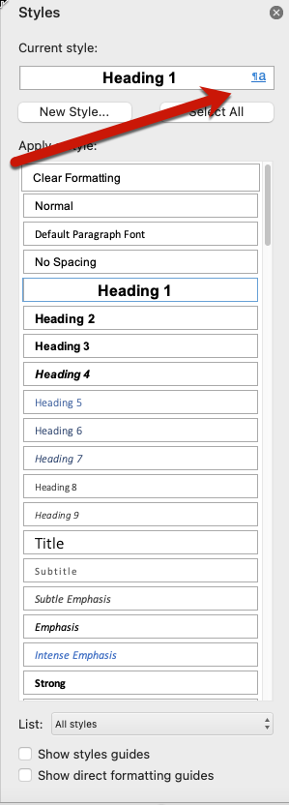
What Are Styles?
Windows Styles
Mac Styles
Formatting Instructions that help all readers make sense of documents (predetermined formatting characteristics for text)
Styles Add Structure
Formatting: Font Type, Size, spacing, indentation, color, Purpose: Heading, Paragraph, List
Paragraph ¶., Character a (no indentation, alignment options), Linked : ¶a (both)
Home Tab > Styles Group
Notes:
A Style is a set of predetermined formatting characteristics for text in a document.
Includes font type, font size, spacing, indentation, borders, bullets or numbers for lists, color, etc. Word offers several styles to “mark up” titles, headings, subheadings, paragraphs, numbered and bulleted lists and much more.
You can modify these built-in styles or make your own.
Paragraph styles are marked with a paragraph symbol: ¶. You can see the paragraph symbol in the Quick Style gallery as well as in the Styles task pane. Click anywhere in a paragraph to apply the style to the entire paragraph.
Character styles are marked with a character symbol: a. Click anywhere in a word to apply the style to the entire word. Or you can select more than one word to apply the style to more than one word.
Linked styles are marked with both a paragraph symbol and a character symbol: ¶a. Click anywhere in a paragraph to apply the style to the entire paragraph. Or you can select one or more words to apply the style to the words that you selected.

Slide 28
Style Types
Character, Paragraph, Character & Paragraph (linked)
Heading Styles
Body Text
Bolding/Italics
List Styles: list appearance
Bulleted Lists
Numbered Lists
Indented lists
Table Styles: table appearance
Data Table
TOC

Slide 29
Why are Styles Important?
Necessary for structure, they mark up a document to define the elements that it contains:
titles, headings, subheadings, paragraphs, lists, tables, headers, among others.
Modify existing styles or create your own based on your formatting preferences.
Provides an organized structure that is easily read by all users including individuals that use assistive technologies like screen readers
Automates formatting process

Slide 30
When are Styles and Formatting Needed?
Apply Heading Styles to:
Main Title
Section Titles
Anything that would appear on a TOC
Manage Spacing between content (paragraph spacing options)
Use Styles Group to format Headings
Direct formatting via Paragraph Group adds the look but not the underlying structure!
Format lists via Paragraph or Styles group

Slide 31
Direct vs Styles Formatting
Direct Formatting: Font Group
Styles Formatting: Styles Pane
Content not accessible to screen readers
Can’t create a TOC
Need to format individual elements one by one
Make Document Accessible
Provide Structure
Quicker navigation to sections of document
Retain document structure when exporting into other formats e.g. PDF

Slide 32
How to Show All Styles Available?
Windows
Mac
From Home Tab, locate "Styles" Group and from lower right corner, click the Styles Task Pane launcher button
The Styles Task Pane will display on your Screen.
To open All Styles, click the Options link on the Styles Task Pane. The Style Pane Options window displays.
Under "Select Styles to Show" select the drop-down button and choose "All Styles".
Click OK button to save options.
Open your Word document and go to the Home Tab.
Locate the Styles pane and select it.
The Styles Task Pane will display on your Screen.
On the Styles pane, select “All Styles” from List drop down menu.

Slide 33
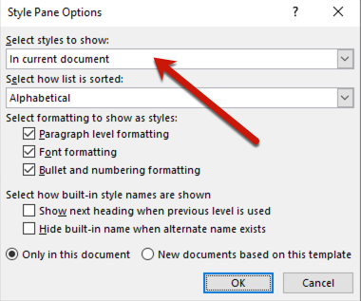
Showing All Styles in Word for Windows and Mac
Windows
Mac

Slide 34
Activity #2
In Sample Word document, locate Quick Styles Gallery and Styles Task Pane
Use Options to have Word show “All Styles” available and browse list
Click on Headings and see what styles are highlighted on Styles Pane

Slide 35
Using Heading Styles

Slide 36
Heading Styles Provide Access
Headings add structure and context to your text
Screen reading software can detect the headings in the document
Screen Reader users can navigate by section/subsections
Add a table of contents quickly
Edit Styles all at once when using Modify Styles option
Automate formatting
Styles are transferred over into other formats e.g. PDF and HTML
Notes:
Connect with the table of contents references “navigation pane is like the table of contents for your document”

Slide 37
Heading Styles (1 of 2)
Built in Heading Styles (H1 to H9)
Use Heading styles for main title, section titles and subsections titles
Apply headings in logical sequence – don’t skip from H2 to H4

Slide 38
Heading Styles (2 of 2)
Heading 1: Apply to Document Title or main content heading
Heading 2: Apply to major section heading
Heading 3: Apply to sub-section of Heading 2
Heading 4: Apply to sub-section of Heading 3
Normal: Apply to text/paragraph

Slide 39
Document Structure with Heading Styles
Top-Level Heading [Heading 1]
Sub-heading to top-level heading [Heading 2]
Sub-heading to top-level heading [Heading 2]
Sub-heading to sub-heading [Heading 3]
Top-Level Heading [Heading 1]
Sub-heading to top-level heading [Heading 2]
Sub-heading to sub-heading [Heading 3]
Sub-heading to sub-sub heading [Heading 4]
Notes:
Main Title, Section Title, Sub-Title
Hierarchically arranged sections
Anything that would appear in TOC/Outline

Slide 40
Review Styles in Document
Open Styles Window
View styles in use
View all styles
Open Style Inspector
Displays Style specifics,
Paragraph and text level formatting,
Open Navigation Pane
Displays all heading styles used
Structure in hierarchical order
Mac Only:
Show style guides
Show Direct Formatting
Notes:
Styles Window Location: Home Tab > Styles Group> Styles Task pane Launcher
Style Inspector: button on styles window

Slide 41
Style Guides on Word for Mac

Slide 42
Navigation Pane
View Tab > Navigation Pane
See all headings in a document, their relative position, and current position.
Will remain blank until styles are applied
Navigate by headings

Slide 43
Formatting Marks
Formatting marks are non-printing characters that reveal the styles of the document
Tabs, spaces, breaks, paragraphs etc.
End of Paragraph: Text ¶
Heading: ▪ Text
Tab: → Text
Space: Text∙text∙text

Slide 44
Activity #3
Open Navigation pane for Sample Document
Use “Show Style Guides” (Mac) or Style Inspector (Windows) to reveal styles/formatting in doc
Optional- show formatting marks
What styles are in use?

Slide 45
Add Heading Styles

Slide 46
Heading Styles: Scenarios
Section text not yet formatted
Use styles window to determine style to apply
Hover mouse over styles to view formatting of style
Select title and apply
Formatted Text
Update style to match selection
Retains original formatting but adds heading style structure

Slide 47
How to Add Heading Styles
No Existing Formatting Example:
Place cursor in front of Document Title or Select Text
Select the Home Tab > Styles Menu > Styles Launcher/Pane
Select Heading 1
Add a Heading 2 style to next section title
What heading style would you apply for subsection of Heading 2?

Slide 48
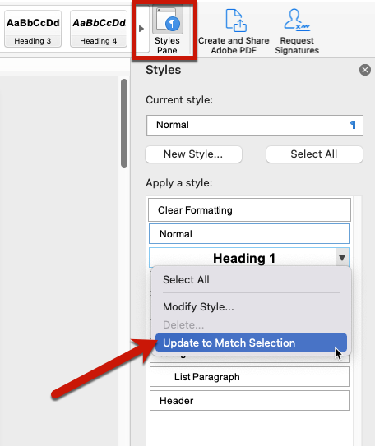
Update Style to Match Selection
Existing Direct Formatting
Scenario:
Select the text that has existing formatting you wish to keep
From Styles Menu locate the heading style you wish to apply
Right Click/Select Down Arrow
Select “Update Heading X to Match Selection”
Text retains original formatting but now has a Heading X Style applied.

Slide 49
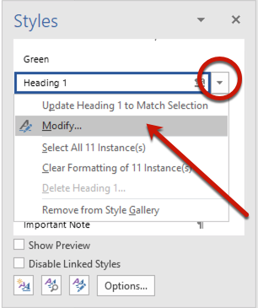
Modify a Style
Modify Default Style Formatting:
Modify heading styles to match your preference
Styles Menu > Heading X > Right Click or click on drop down arrow> Select Modify Style
Make Changes under Formatting Area
Notes:
Style modifications will reflect in document wherever that style was applied. All text with style applied will update automatically to reflect modifications.

Slide 50
Modify Style Window
Properties: Style Name and Type
Formatting: Font, Paragraph, Border, Tabs, Numbering, Paragraph Spacing, Text Placement…

Slide 51
More Style Scenarios
List Style
Italic (emphasis), Bold (Strong)
Create New Styles
Accessible Text Box
Announcement Text
Alert Text

Slide 52
Style Tips
Style doesn’t look right?
Apply normal or clear all
Re-apply style
Create a Quick Style Set for Document
Create templates that contain formatting preferences for future use .dot, .dotx
Notes:
Resetting Quick Styles:
“Reset Document Quick Styles”
Undo changes and re-applies quick style set attached to original document
“Reset to Quick Styles from Template
Undo changes and re-applies default quick style set used by Word
Save your applied styles as a Quick Style Set
Style Set available on your computer only
Styles (not the set) will become available on any computer you open the document
Style Set Automates your formatting with the click of a button

Slide 53
Activity #4
Add heading styles to main title/section titles
Apply direct formatting to a section title and update a style to match existing formatting
Modify one of the applied styles

Slide 54
Working with Images

Slide 55
Add Alternative Text to Images
Provide Alt Text Descriptions for Images
Right Click > Edit Alt Text
Select Image > Picture Format Tab > Alt Text
Concise and Meaningful Descriptions
Avoid starting description with “Image of”
Long Descriptions written next to image
Mark as “decorative” when appropriate

Slide 56
Adding Alt Text Example

Slide 57
Alt Text vs. Caption
Alt Text
Image Caption
Alternate text is read aloud to someone using assistive technology, but is hidden from a sighted user
Include more description in alt text if adding caption as well to avoid redundancy
Image Caption is Text that displays on the screen
Screen readers will read both alt text and caption
Add if no alt text option (older Mac word versions)
References Tab > Insert Caption
Notes:
For older versions of Word on a Mac, e.g. Word 2008, the alt text option is not available so Office 365 online can be used or add a caption
An image caption is text that displays on the screen. Alternate text is read aloud to someone using assistive technology, but is hidden from a sighted user.
If your image will also have a caption, consider including more descriptive detail of what you see in the picture in the alt text compared to the text in the caption. A screen reader will read both the alt text and the caption, and redundancy can be frustrating to the user
Mac Users: Add Caption (if no alt text tab option) Ctrl + click > Insert Caption > Figure 1…
Caption appears below/above image, carried over into PDF/HTML
OpenOffice Word for Mac (add alt text option available)
Windows: Add Caption
References Tab > Captions group > Insert Caption. Appears below/above image.

Slide 58
Alt Text Tips
Avoid Clutter
Avoid using images as Background
Decorative vs. Meaningful
Decorative images do not present important content or are used for non-informative purposes.
Do not require alt text.
Notes:
Decorative Images
Decorative images do not present important content, are used for layout or non-informative purposes, and do not appear within a link.

Slide 59
Graphs, Charts, & Figures
Add Alt Text, Don’t rely on color to convey meaning
If needed add long description next to image within document
Begin description by introducing name and type of object e.g. Annual Sales Pie Chart…
Notes:
Long Description Example: Annual Sales Pie Chart indicates that during the 1st quarter 58% sales were accomplished, 2nd quarter there were 23% of sales accomplished, 3rd quarter there were 10% sales accomplished and in the 4th quarter there were 9% sales accomplished.

Slide 60
Chart Example

Slide 61
Activity #5
Add Alt Text to the Image in Document
Add a Caption to the Image in Document

Slide 62
Working with Hyperlinks

Slide 63
Use Descriptive Hyperlinks
Descriptive Links:
Sac State Home Page
Meaningful to users of screen readers
Insert + F7 keystrokes provides list of links in document using JAWS
Navigate content easily
Plain URL:
http://www.csus.edu
Not meaningful
User can get lost
List of URL’s not helpful to navigation of content
Can place URL as a footnote (not enabled) for print purposes

Slide 64
Adding Descriptive Links
Type a Descriptive Label for Link in Document
Select text > Right Click > Select Hyperlink
Text to Display Box: Verify/Enter Descriptive label
Address Box: Enter URL
Click OK
Test Link: CTRL + Click

Slide 65
Activity #6
Locate URL’s in document,
Copy and paste URL into browser – take note of page it opens,
Convert URL into a descriptive labeled link,
Test link

Slide 66
Working with tables

Slide 67
Accessible Tables (1 of 2)
Keep tables simple
Screen readers read tables from left to right
Avoid nested tables/complex
Add Table Headers in Word
Select Header Row > Right Click (ctrl +click on Mac) > Table Properties > Row Tab > “Repeat as Header Row”
Table Design/Design Tab > Select Header Row
Adds TH (Table Header) tag
Add Alt Text to provide table summary
Notes:
Identify Table Headers
Locate Table on Document and select it (click in it).
Table specific context menus will display on the Word Ribbon.
Mac Users: Click the "Table Design" tab
Windows Users: Table Tools > Design Tab
The first group of tools on this tab: "Table Style Options" group, provides several checkboxes. Select the check box next to "Header Row".
The Header cells that you selected will now be identified as table headers.

Slide 68
Accessible Tables (2 of 2)
Do not allow rows to break across sections (Table Properties)
Do not use heading styles in table header cells,
Modify cell margins instead of using “enter” key to create space around content in table cells
Select cells > table properties > cell tab > options button>.10 -.15)
Add Long Description (Table Summary) below table if necessary
Add Table Caption – Serves as Title for table
Notes:
Tbd: No mechanism in Word to identify Row header; only Column Header,
Add a Table Caption
Captions function as a heading/title for your table. Captions should be short and summarize overall purpose of table.
Select all table (highlight or use table select icon) located at top left of table.
Right click on table and select "Insert Caption"
The Caption window displays. Complete the following fields:
Caption: This field may already display the words "Table 1" follow this with a summary of your table.
Label: Depending on the object you select, this will be pre-populated. Make sure Table is selected.
Position: Choose to place summary above or below table. Below is recommended.
Format: This ties to the label area. Default is arabic numbers (1, 2, 3). Choose your preference.
You can choose to exclude the label from caption if you wish. Not recommended if you have several tables on documents.
Click OK to save changes. The table caption will appear.

Slide 69
Activity #7
Locate Table in Document
Identify the Header Row and Select it
Add the Table Header tag

Slide 70
Video Accessibility

Slide 71
Captioned Video
Use Captioned Videos
Transcripts for Audio
Checkout Captioning Resources at Sac State
Panopto - Captioning
Zoom Video - Captioning

Slide 72
Accessibility Checker

Slide 73
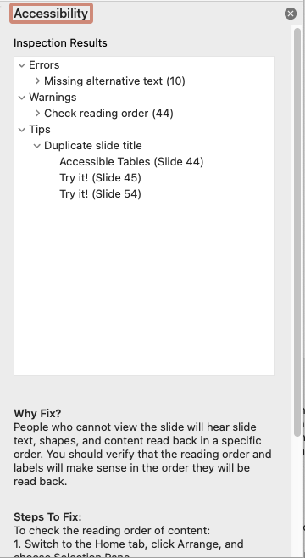
Use Accessibility Checker in Word
Select the Review tab and click Check Accessibility.
Word Summarizes Issues as:
Errors: makes it impossible to access
Warnings: Difficult to access content
Tips: Recommendation to improve access
Fix Issue using steps provided
Notes:
Older versions of Windows:
Windows Users: Locate the Accessibility Checker from the File tab in the Info group under the Check for Issues option

Slide 74
Alternative formats

Slide 75
Make Available in Source Format
First step is to make document accessible
Facilitates process to convert into alternative formats
Whenever possible make available in source format: .docx,
Other formats: RTF, PDF, or HTML
Large print, Braille, mp3 audio etc.
Ally Alternative Formats in Canvas
Notes:
Hyper Text Markup Language “HTML”
File > Save As > Web Page “Filtered”
Filtered option does not carry over unnecessary information
Carries over Alt Text, Table Headers, links
Edit in Dreamweaver or other web editor
Rich Text Format “RTF”
File > Save As > RTF
Read across different word processing applications

Slide 76
How to Save as An Accessible PDF
Portable Document Format “PDF”
Save as PDF from Office 365 online
From Computer: File Menu > Save As > File Type: PDF
Mac Users: Under the File format drop down, be sure that the option for “Best for electronic distribution and accessibility (uses Microsoft online service)” is selected.
Word Users: Click the options button and verify that the “Document Structure Tags for Accessibility” option is selected.
Adobe Acrobat Standard/Pro – “Create PDF” option in Word
Notes:
Office for Mac
Older versions Cannot create tagged PDF from Office on Mac
File > PDF
Add Tags in Adobe Acrobat: Review, Repair, Review process…
Use Office 365 via University or OpenOffice for Mac
File > Export as PDF > General Tab > select “tagged PDF” checkbox
Save As PDF (Newer versions of Office or if Adobe Acrobat is installed)

Slide 77
Saving a Word Doc as PDF

Slide 78
Use Ally in Canvas to Convert Document into Alternative Format

Slide 79
What is ALLY?
External tool that is integrated into Canvas
Scans course content and generates an Accessibility score for:
Individual files uploaded to a course
Course as a whole
Scores are only visible to instructors/course owners
Creates Alternative Formats for files based on original

Slide 80
Alternative Formats in Ally
Alternative formats communicate information other than in a standard text format.
Electronic Braille
Audio
PDF, OCR
PDF, Tagged
Semantic HTML
ePub
Translated Version
BeeLine Reader
*Alternative formats are based on Original file so they are only as good as original in terms of access
Notes:
Electronic Braille: BRF file that can be read on a refreshable Braille Display, other braille devices or braille software.
Audio: .mp3 file download, audio alternative reads aloud text in file.
PDF, OCR: Optical Character Recognition or OCR is used to convert an image only PDF to searchable text. Conversion is only as good as original file, may not be accurate if file has issues.
PDF, Tagged: File format containing tags to identify headings, paragraphs to aid in reading of document by screen readers.
Semantic HTML: viewed on a browser and file type provides tags and elements (blockquote, paragraph, headings) that add meaning to the content and helps screen reader users.
ePub: digital publishing file for view on mobile devices. This file format is reflow-able meaning it adapts to the device on which content is viewed.
Translated Version: option to obtain the audio file for content in another language.
BeeLine Reader: file format that displays text using subtle color gradient to aid in reading on screen content.

Slide 81
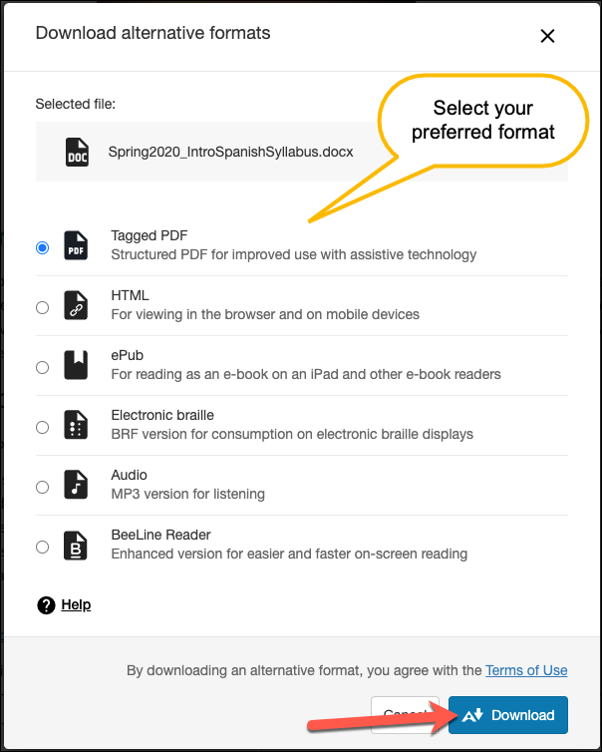
Download Alternative Formats
Click the Alternative Format downward arrow to the right of the file’s name
Select “Alternative formats”
From “Download alternative formats” window select the format you want
Notes:
If you are accessing a file from within a module, you will need to click on the file name first to load the file preview and you will see the alternative format link above the file preview window. The Download Alternative Formats window will then open and display the available options to choose from. The alternative formats created depend on the original file type. For example, a PowerPoint will have options for a tagged PDF, HTML, ePub , electronic braille, and audio formats.

Slide 82
Use Ally in Canvas to Check Document Accessibility
Upload Document to Canvas
Accessibility indicators display next to files posted in:
Files, Modules, Pages, Canvas Tools RCE Areas: Assignments, Quizzes, etc.
Click indicator to Launch Instructor Feedback Panel
Notes:
Other ways to check document:
Use built in Read Aloud feature in Word – may not reflect true assistive tech experience
Use JAWS to Read Document
Start JAWS: CTRL + Alt + J
Use Shortcuts

Slide 83
Ally File Accessibility Scores
Scores Range from Low to Perfect
Associated Dial in one of the following colors:
Low Score 0-33% immediate attention needed
Medium Score 34 – 66% somewhat accessible
High Score 67 – 99% accessible can be improved
Perfect Score 100% accessible, no improvement needed
Notes:
Accessibility scores range from Low to Perfect and depending on the score, you will see an associated dial in one of the colors listed below along with a percentage value. A higher score means fewer accessibility issues in a file. Scores are only visible to instructors/course owners. Your students will only see options to download an alternative file format for original files next to the original file. Depending on the File type, ALLY will check for things like headings, alternative text for images, color contrast, descriptive links and any issues within these areas contribute to the final score for that file.
Accessibility score: Perfect Click to improveRed Dial- Low Score 0% to 33%: File is not accessible and needs immediate attention.
Accessibility score: Perfect Click to improve Orange Dial - Medium Score 34% to 66%: File is somewhat accessible and could use improvement
Accessibility score: Perfect Click to improveLight Green Dial - High Score 67% to 99%: File is accessible but could be improved
Accessibility score: Perfect Click to improveGreen Dial - Perfect Score 100%: File is accessible, no improvement needed.

Slide 84
How to Fix Issues
Click the Accessibility Indicator/Dial next to File
Review Issues summarized in Instructor Feedback Panel
Issues can be fixed External to Canvas in appropriate Application e.g. Word, Adobe, PowerPoint
Exception: Adding Alt Text to Image files
Locate source file on computer or download file from Canvas
Replace file that has issues with remediated file via instructor feedback panel

Slide 85
Activity #8
Convert into PDF
Open in Adobe Acrobat and Check Tags
Upload to Canvas and Download an Alternative Format
Download HTML Alternative format or Audio Version
Take note of Accessibility Score for File in Canvas via Instructor Feedback Panel

Slide 86
Summary
Structure
Styles and Formatting
Alternative Text for Images
Descriptive Labels for Links
Simple Tables
Alternative Formats
Review with Built in Accessibility Checkers and Ally in Canvas

Slide 87
Accessibility Resources
Accessibility at Sacramento State
Universal Design for Learning Program
Online Teaching Resources: Course Accessibility
The CSU Accessible Technology Initiative
Free WebAIM Accessibility Training
Notes:
WebAIM’s Resources Page (http://webaim.org/resources/) provides a variety of tools, guides and simulations.

Slide 88
Academic Technology Center
916.278.2450 atc@csus.edu

